Slide 1

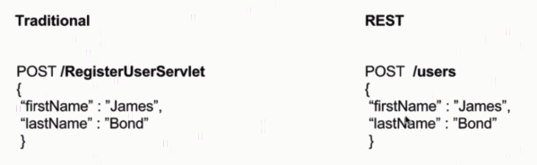
Resource and Collection URI

Slide 2

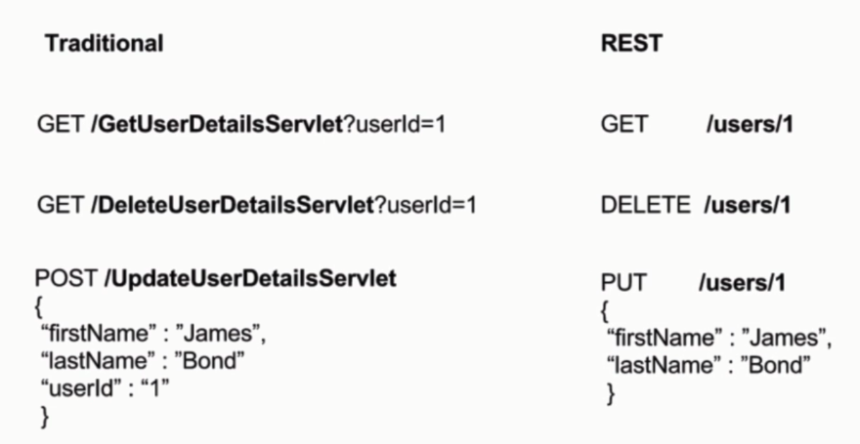
Resource and Collection URI

Slide 3
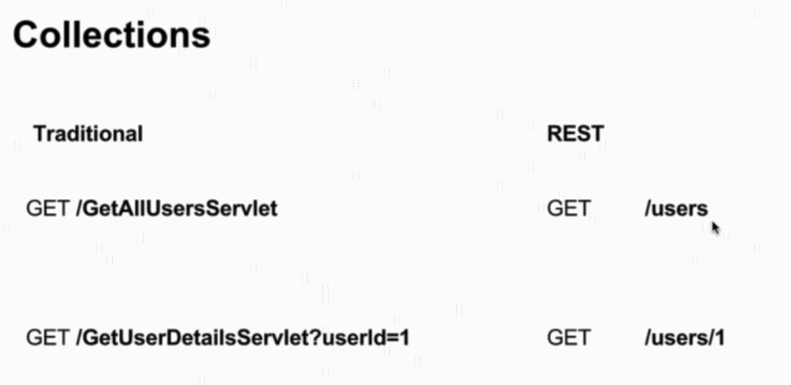
Resource and Collection URI

Slide 4
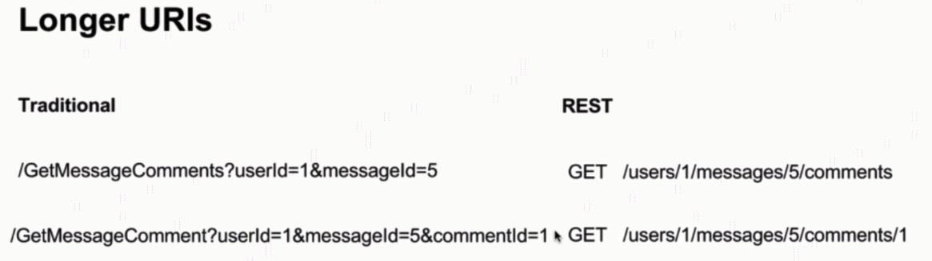
Resource and Collection URI

Slide 5
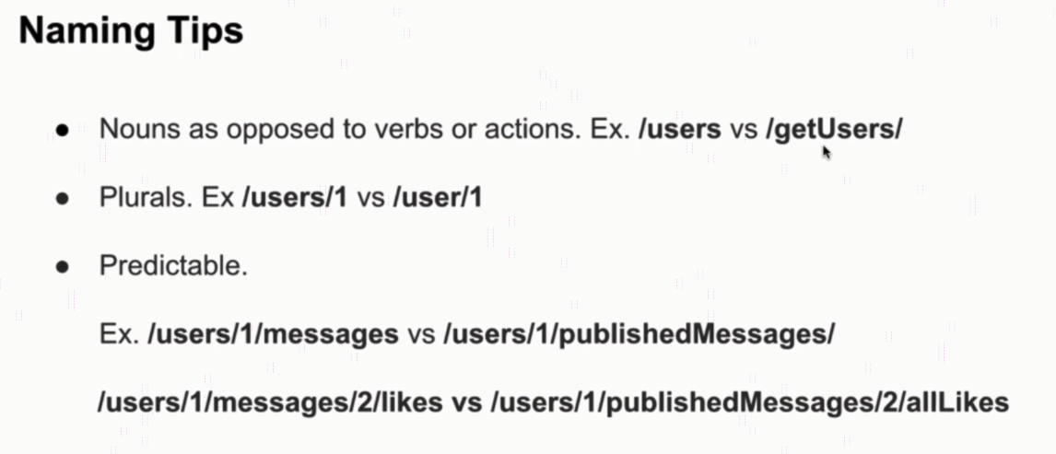
Resource and Collection URI

